Slide 1
Dynamics of
Language Death
Roshani Narasimhan | 201301104
Sai Sruthi Talluri | 201301143
Khyati Mahajan | 201301406

Slide 2
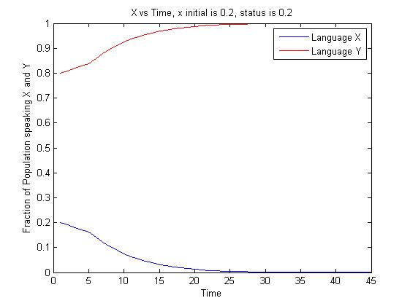
1. Less initial speakers, less status of language X
Initially, there are less speakers of language X. As the status of the language Y is more as compared to language X, speakers of X eventually migrate to language Y. Thus the fraction of population speaking X tends to 0 and the fraction of population speaking Y tends to 1. Here, x approaches the stable fixed point of x = 0.

Slide 3
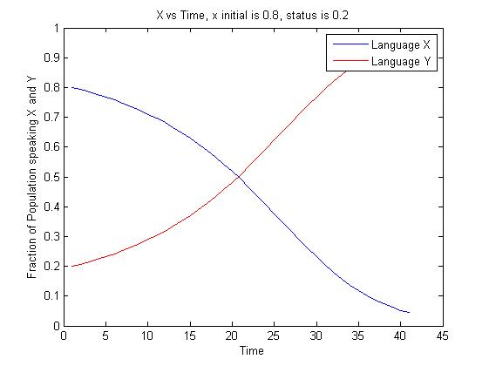
2. More initial speakers, less status of language X
Initially, there are more speakers of language X. As the status of the language Y is more as compared to language X, speakers of X gradually migrate to language Y. Thus the fraction of population speaking X decreases and the fraction of population speaking Y increases. Thus x approaches the unstable fixed point which lies between 0 and 1.

Slide 4
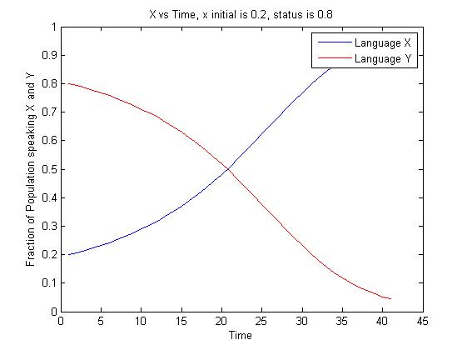
3. Less initial speakers, more status of language X
Initially, there are less speakers of language X. As the status of the language X is more as compared to language Y, speakers of Y gradually migrate to language X. Thus the fraction of population speaking X increases and the fraction of population speaking Y decreases. Here , x approaches the unstable fixed point which lies between 0 and 1.

Slide 5
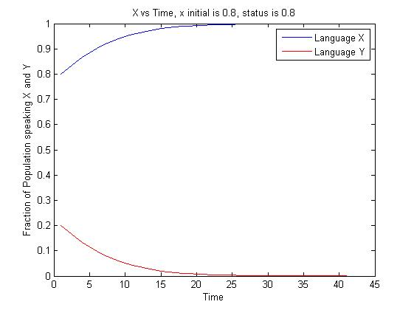
4. More initial speakers, more status of language X
Initially, there are more speakers of language X. As the status of the language X is more as compared to language Y, speakers of Y abruptly migrate to language X. Thus the fraction of population speaking X tends to 1 and the fraction of population speaking Y tends to 0. Here, x approaches the stable fixed point of x = 1.

Slide 6
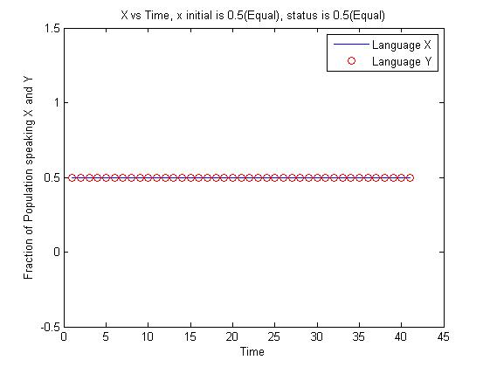
5. Equal speakers and status of languages X and Y
When the status and the fraction of population speaking X and Y are all equal to 0.5, x remains at the unstable fixed point at x=0.5. This means that the migration of speakers between both the languages are equal.

Slide 7
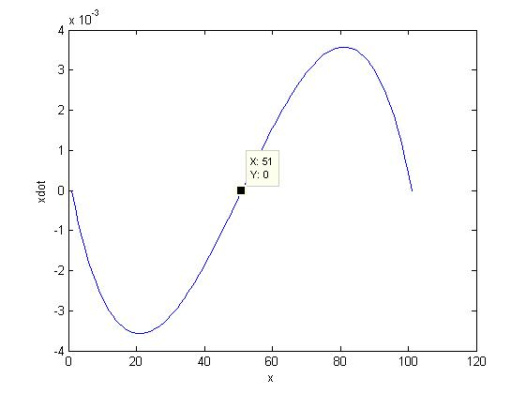
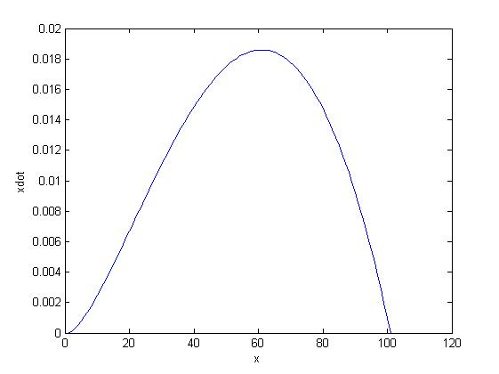
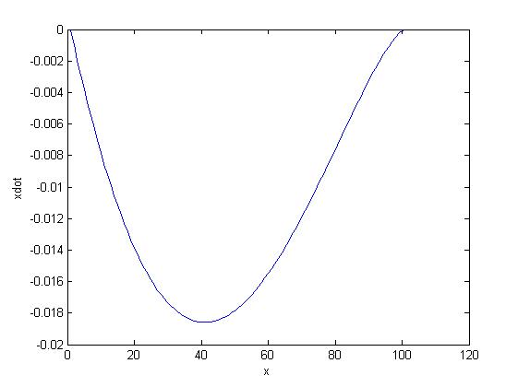
Phase plots fixed points, s=0, 0.5, 1

Slide 8
Language dynamics in a bilingual population
The monolingual model does not take into consideration the bilingualism exhibited by the speakers of the population.
This model takes into consideration the language dynamics exhibited by the fraction of the population that is bilingual.
The languages X and Y are both taken to be spoken by a person considering the factor of their similarity, denoted by a factor k, which describes them being the same if k=1 and completely dissimilar if k=0.

Slide 9
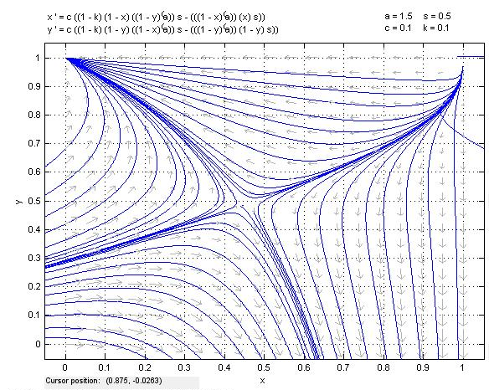
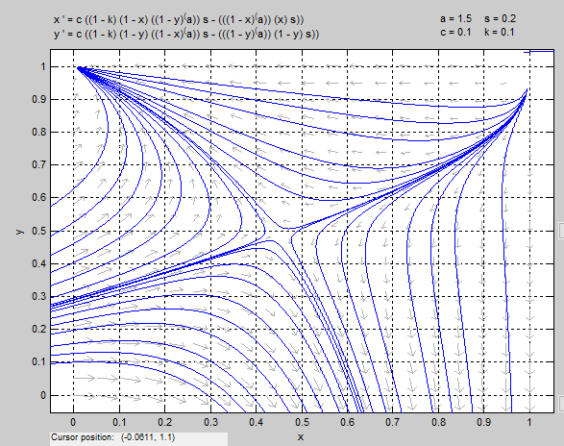
Phase plots for 2D bilingual model
k=0.1, unsimilar languages, both the languages are always persistent. The fixed obtained is a saddle node fixed point.

Slide 10
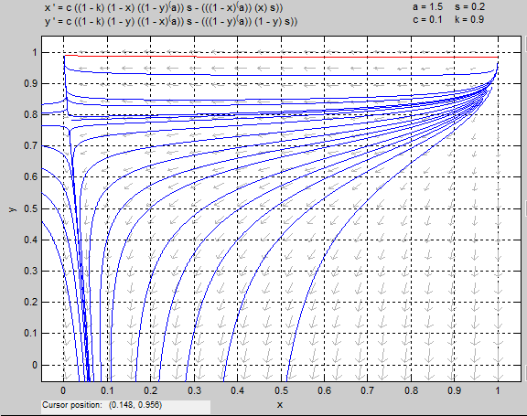
k=0.9, similar languages, so the fraction of population that is bilingual will increase and thus the fraction of population speaking only one language will decrease.

